Slide 1
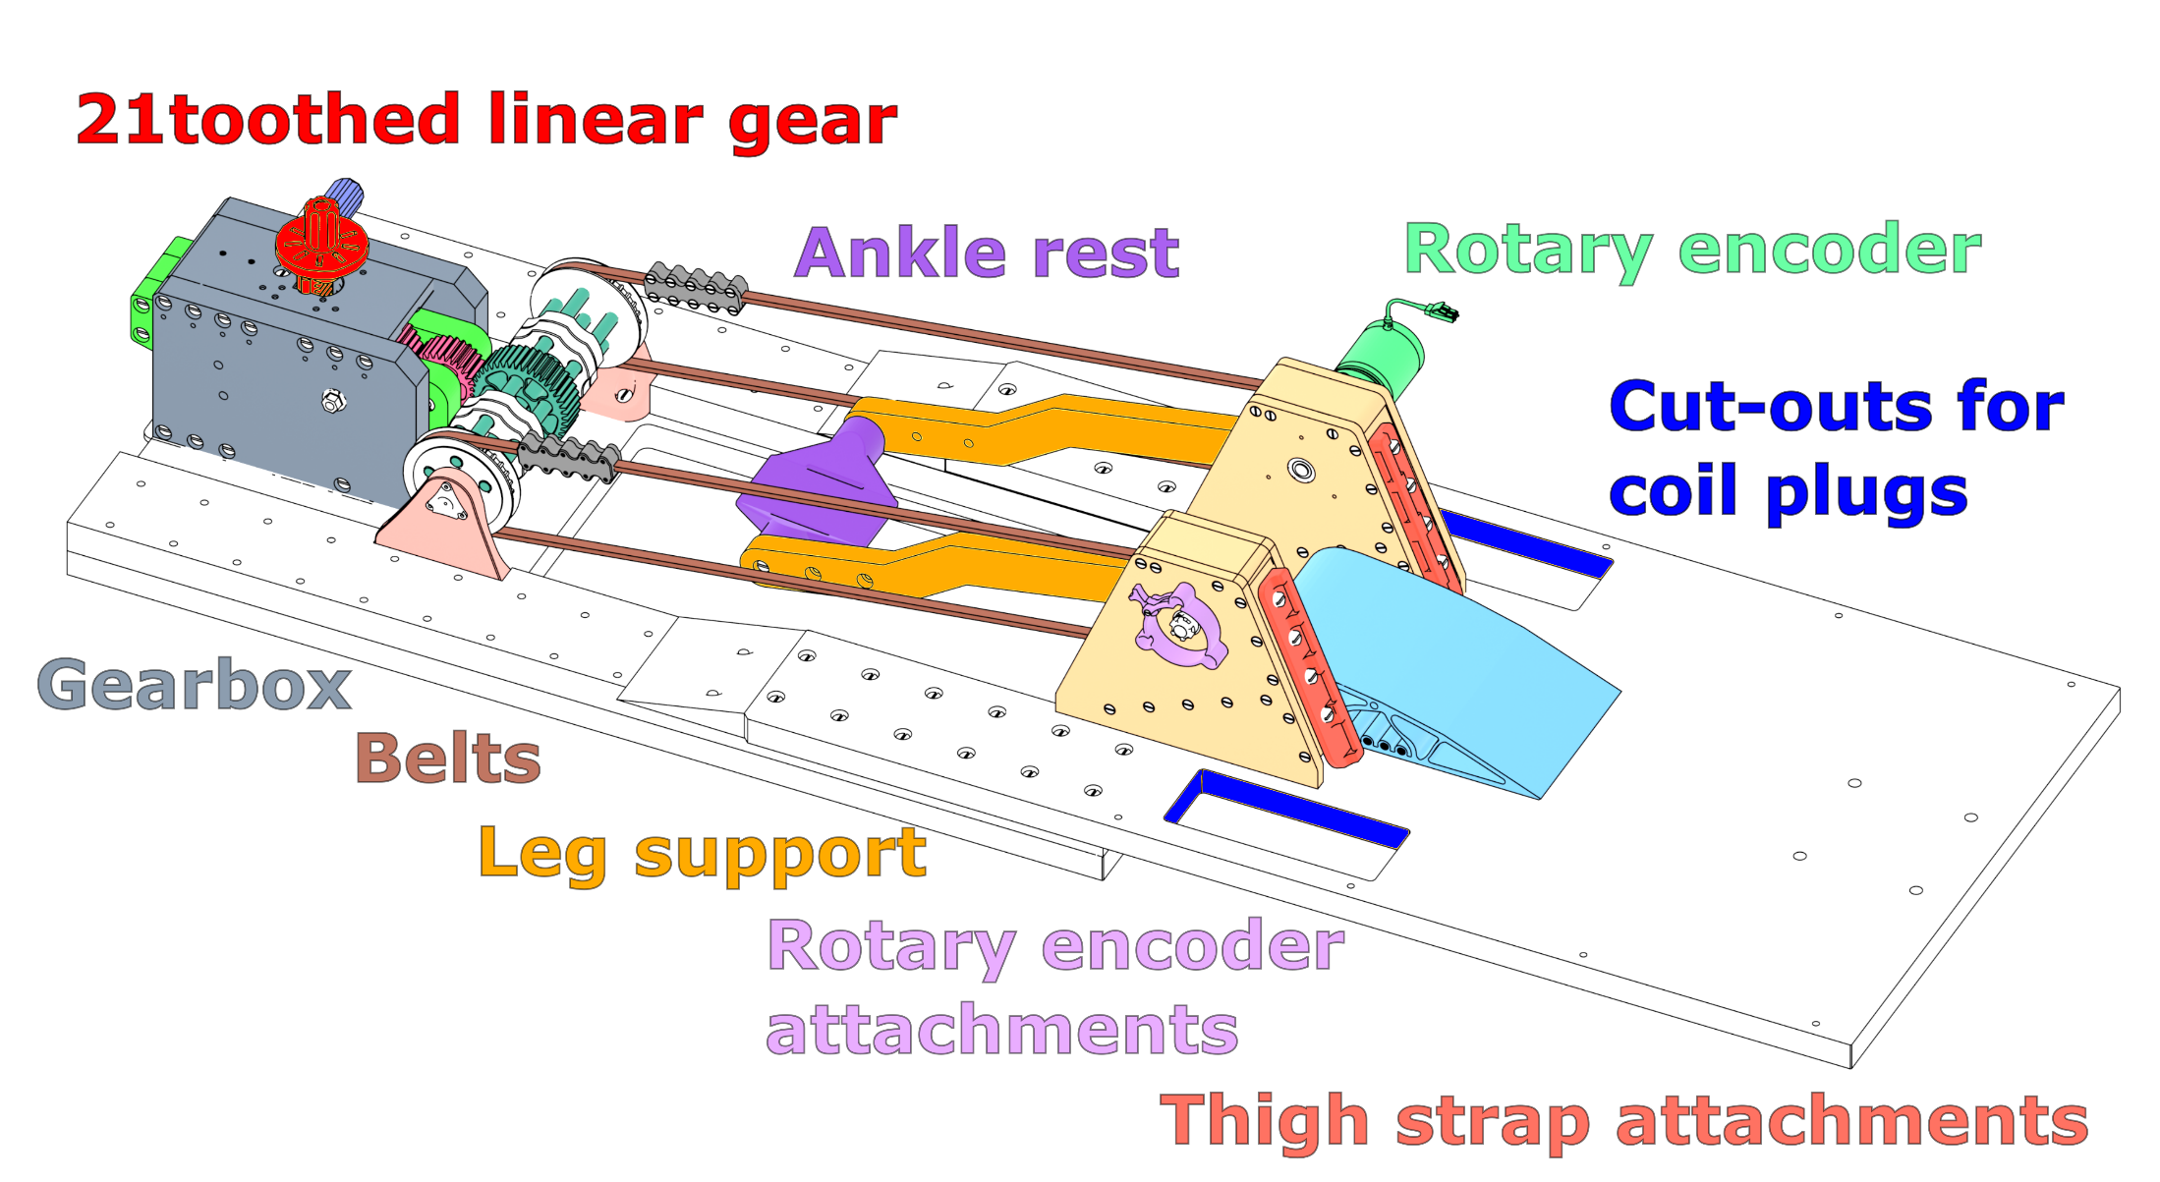
High resolution CINE imaging of guided knee motion using golden-angle radial MRI and a novel knee loading device
5599
Martin Aleksiev¹, Martin Krämer^{1,2}, Nicholas M. Brisson³, Marta B. Maggioni¹, Georg N. Duda³, Jürgen R. Reichenbach¹
¹ Medical Physics Group, Institute of Diagnostic and Interventional Radiology, Jena University Hospital, Friedrich Schiller University Jena, Germany ² Institute of Diagnostic and Interventional Radiology, Jena University Hospital, Friedrich Schiller University Jena, Germany ³ Julius Wolff Institute, Berlin Institute of Health at Charité - Universitätsmedizin Berlin, Germany
Slide 1/8
It is relevant to evaluate musculoskeletal joint conditions in the context of motion as abnormalities can be implicated in the onset and progression of degenerative conditions such as osteoarthritis
An MRI-safe device that allows guided and loaded knee motion within the scanner bore, a rotary encoder and reconstruction techniques such as CINE help achieve high-resolution imaging during joint motion
For a detailed description of the device: doi:10.1016/j.zemedi.2021.12.002
Introduction
Notes:
In our work we present high resolution dynamic CINE imaging of the knee using golden-angle radial MRI and a novel knee loading device.
The MRI compatible knee loading device shown below is positioned as an extension of the MRIs patient table.
The subjects or patients ankle is positioned within the leg support and motion is translated via belts to a gearbox that can be adjusted so that an attached weight is either pushed up or down.
Attached to the device is an optical high precission industry standard and MRI compatible rotary encoder that records the knee flexion angle in real-time.
Knee flexion angles are recorded as an encoded voltage signal that is combined with a sequence trigger which the imaging sequence outputs at each sequence repetition.

Slide 2
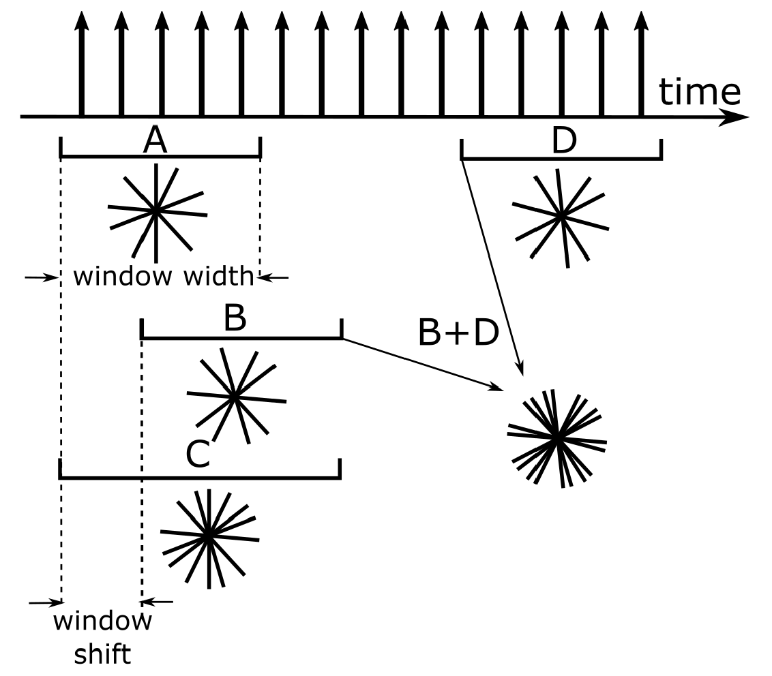
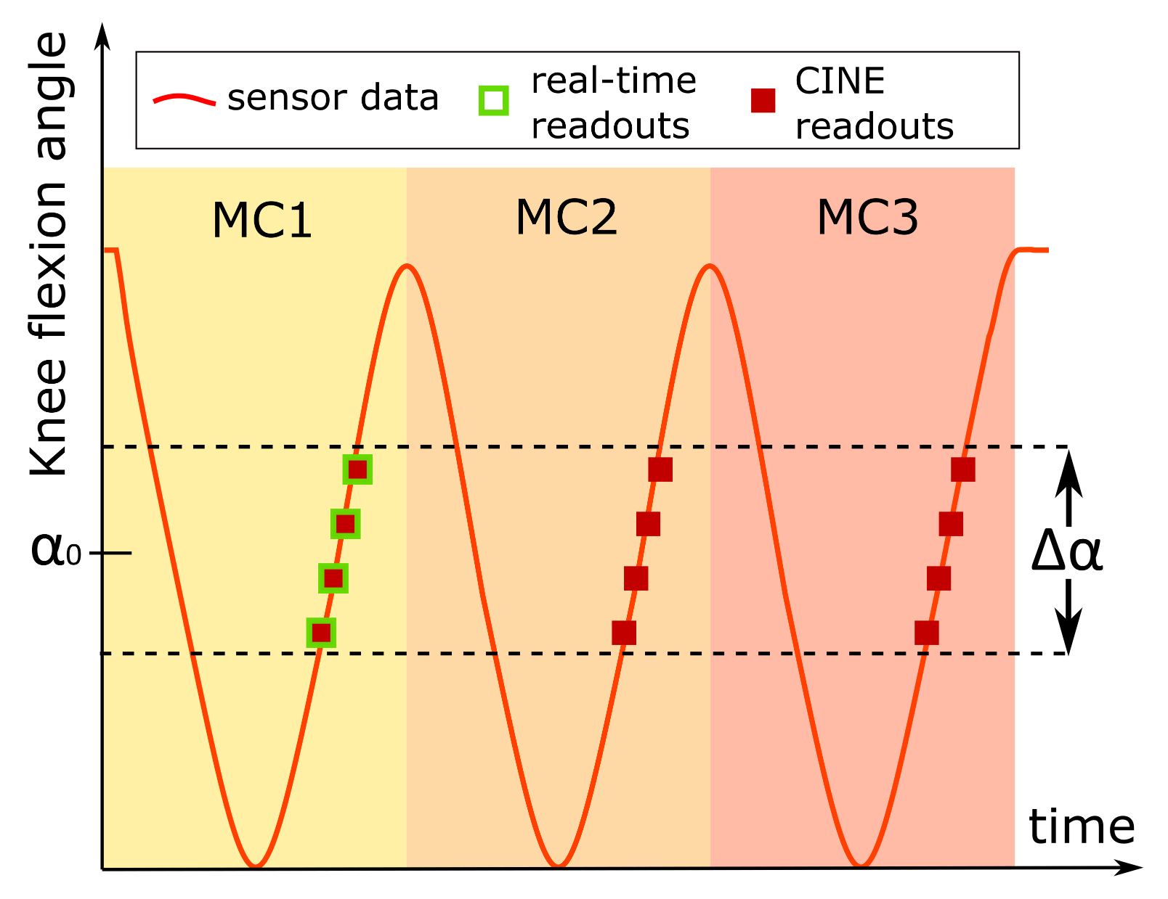
High resolution CINE imaging of guided knee motion using golden-angle radial MRI and a novel knee loading device
5599
Martin Aleksiev¹, Martin Krämer^{1,2}, Nicholas M. Brisson³, Marta B. Maggioni¹, Georg N. Duda³, Jürgen R. Reichenbach¹
¹ Medical Physics Group, Institute of Diagnostic and Interventional Radiology, Jena University Hospital, Friedrich Schiller University Jena, Germany ² Institute of Diagnostic and Interventional Radiology, Jena University Hospital, Friedrich Schiller University Jena, Germany ³ Julius Wolff Institute, Berlin Institute of Health at Charité - Universitätsmedizin Berlin, Germany
Slide 2/8
Synchronizing the position sensor data with the readout acquisition timestamps allows for real-time and CINE reconstruction of images at any given angular positions with a given range of angles (referred to as angle window) with freely adjustable window width and temporal window shift.
CINE reconstruction
Notes:
By knowing which radial golden-angle readout was acquired at exactly what knee flexion angle we can then define an angle window that is used for reconstruction of a single frame.
In comparison to real-time imaging we can also include readouts from multiple motion cycles to reduce undersampling and fill k-space sufficiently, possibly allowing for high-resolution images to be acquired.
Due to the continous golden-angle radial acquisition the width of the angular reconstruction window can be freely chosen and adapted during image reconstruction, ultimately making it possible to chose and adjust a trade-off between angular precission and the number of readouts that are available for the reconstruction of each frame.
To reconstruction continous CINE frames of the knee motion the window center is shifted during reconstrucction, again enabling a high flexibility in how many frames to reconstruct.

Slide 3
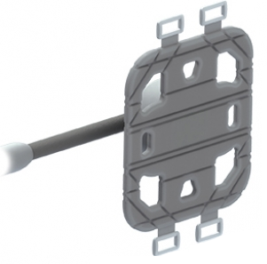
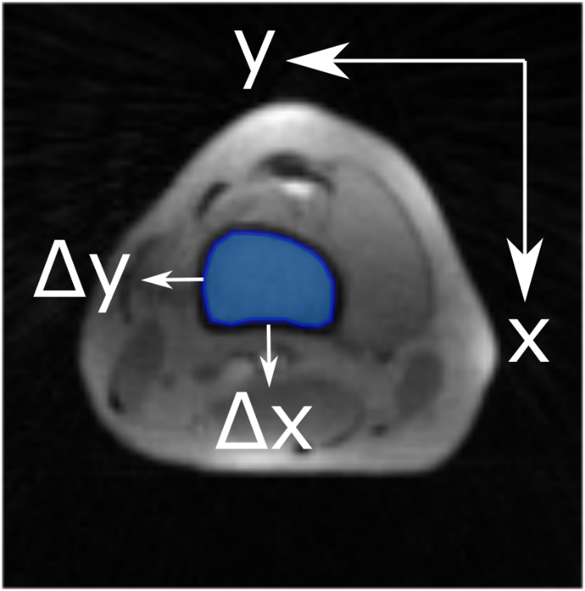
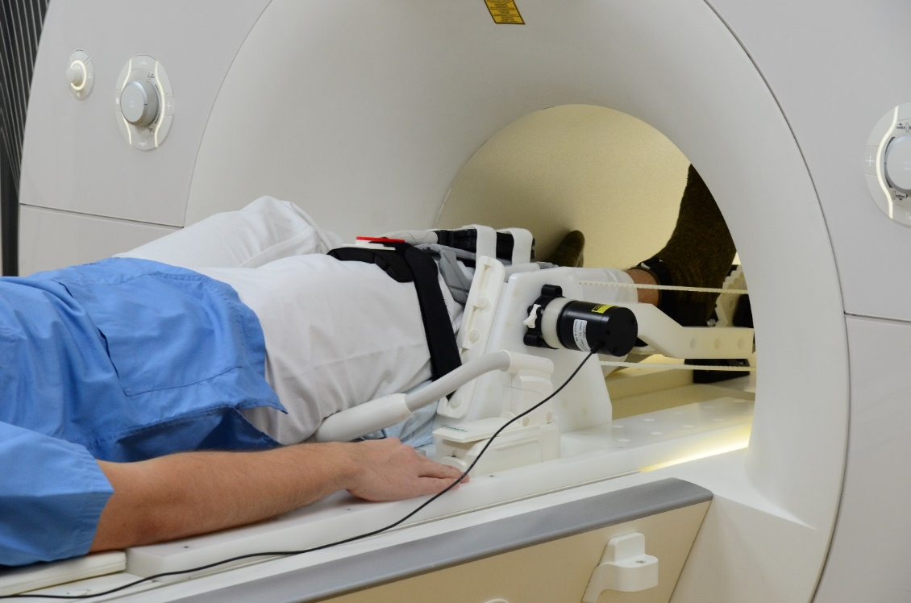
High resolution CINE imaging of guided knee motion using golden-angle radial MRI and a novel knee loading device
5599
Martin Aleksiev¹, Martin Krämer^{1,2}, Nicholas M. Brisson³, Marta B. Maggioni¹, Georg N. Duda³, Jürgen R. Reichenbach¹
¹ Medical Physics Group, Institute of Diagnostic and Interventional Radiology, Jena University Hospital, Friedrich Schiller University Jena, Germany ² Institute of Diagnostic and Interventional Radiology, Jena University Hospital, Friedrich Schiller University Jena, Germany ³ Julius Wolff Institute, Berlin Institute of Health at Charité - Universitätsmedizin Berlin, Germany
Slide 3/8
Single transverse slices of the knee acquired with a radial golden-angle gradient-echo FLASH sequence
Transverse slice through the femur acquisition parameters: 144 × 144 matrix, 220 × 220 mm² field of view, 1.5 × 1.5 mm² spatial resolution, 4.8 mm slice thickness, 10° flip angle, 2.4 ms echo time, 5.1 ms repetition time, using 200 sequence repetitions with acquisition duration of 3:51 minutes
Measurements were performed on a 3T Siemens PRISMA MRI scanner using two 8 channel NORAS Variety coil wrapped around the knee
Five healthy volunteers (age range 22 to 37 years) performed continuous flexion-extension motion cycles with motion speed of 7.5 cycles/minute
NORAS Variety Coil
Leg displacement analysis of repeated knee motion
Notes:
As a first step we looked at the stability of the leg position throughout repeated motion cycles.
For this purpose a transverse slice through the femur was acquired for 5 healthy volunteers that performed a repeated knee flexion-extension motion for almost 4 minutes..
To be able to reconstruct real-time images a rather slow motion speed of 7.5 motion cycles per minute was chosen.
For a knee angle of 25° a region of interest was drawn around the femur contour in the first motion cycle.
Subsequently this region of interest was manually shifted to match the femur position in the real-time reconstructed images of all other motion cycles whereat the shape of the region of interest was kept fixed.
Relative shifts of the region of interests between different motion cycles were then calculated from region of interests center of mass.

Slide 4
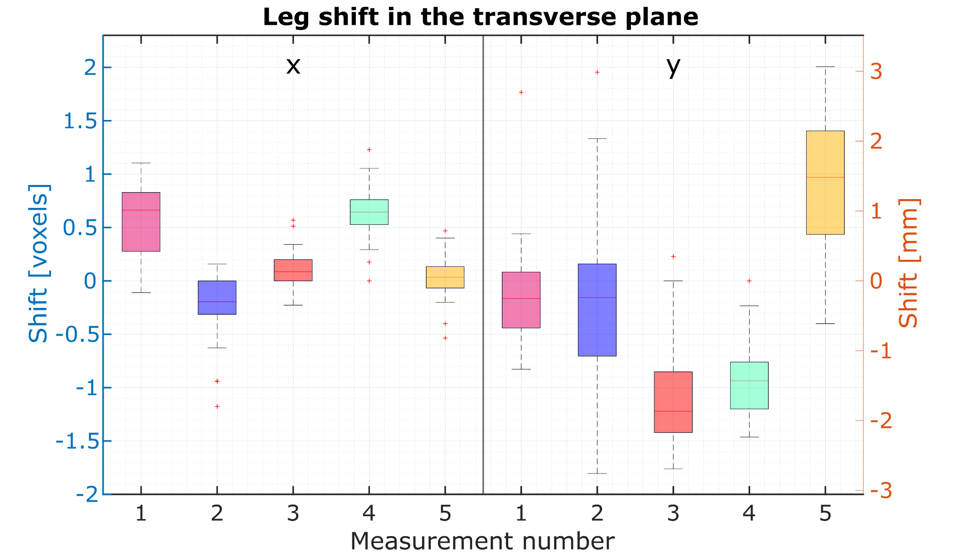
High resolution CINE imaging of guided knee motion using golden-angle radial MRI and a novel knee loading device
5599
Martin Aleksiev¹, Martin Krämer^{1,2}, Nicholas M. Brisson³, Marta B. Maggioni¹, Georg N. Duda³, Jürgen R. Reichenbach¹
¹ Medical Physics Group, Institute of Diagnostic and Interventional Radiology, Jena University Hospital, Friedrich Schiller University Jena, Germany ² Institute of Diagnostic and Interventional Radiology, Jena University Hospital, Friedrich Schiller University Jena, Germany ³ Julius Wolff Institute, Berlin Institute of Health at Charité - Universitätsmedizin Berlin, Germany
Slide 4/8
Leg shift in the transverse plane
Real-time images were reconstructed at the same leg angular position for all 5 scans for 28 motion cycles that the subjects performed
A region of interest (ROI) was drawn around the femur for the first frame, then copied and translated to the remaining 27 frames such that it fit the femur
Results: Leg displacement
The ROI shift in the x- and y-directions was determined based on the position of the center of mass of the ROIs. The average shifts across all measurements and volunteers was 0.26 voxels (0.39 mm) for the x-direction and 0.56 voxels (0.84 mm) for the y-direction.
Notes:
The average shifts across all measurements and volunteers was 0.26 voxels (0.39 mm) for the x-direction and 0.56 voxels (0.84 mm) for the y-direction.
For most measurements the laterial and anterior shifts of the femur during repeated motion cycles was well below one voxel.
This suggest, that when using readouts from multiple motion cycles only marginal blurring due to leg displacements can be expected.

Slide 5
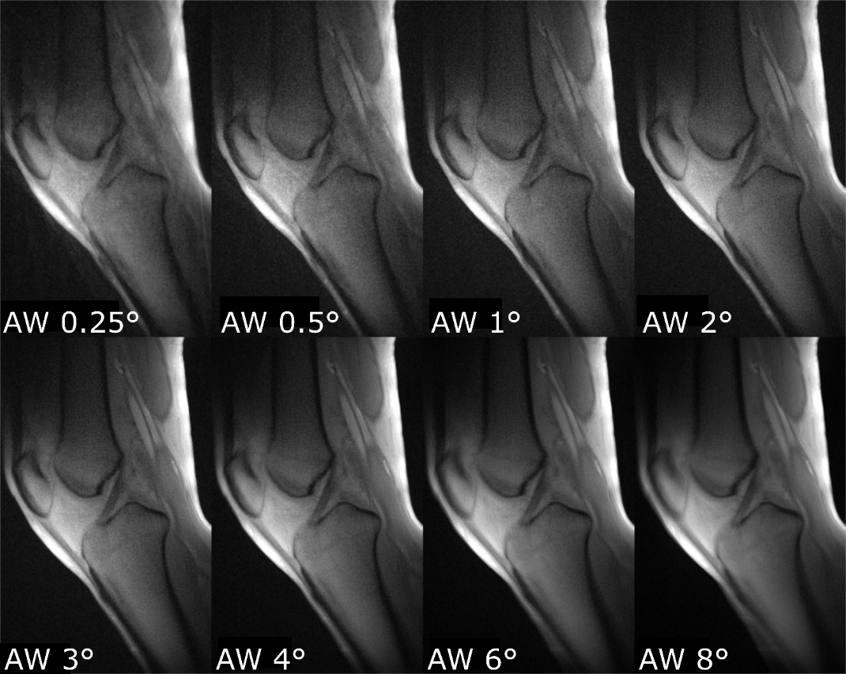
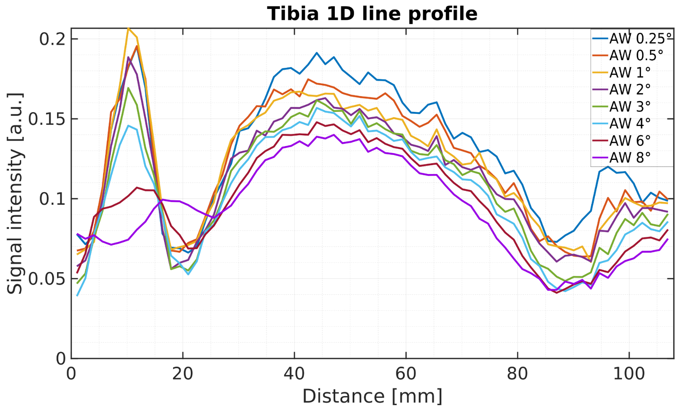
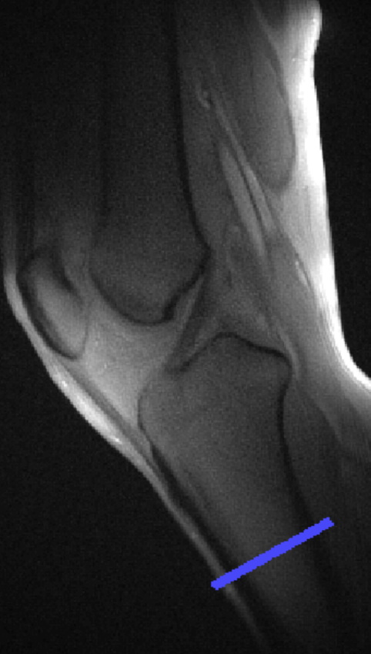
High resolution CINE imaging of guided knee motion using golden-angle radial MRI and a novel knee loading device
5599
Martin Aleksiev¹, Martin Krämer^{1,2}, Nicholas M. Brisson³, Marta B. Maggioni¹, Georg N. Duda³, Jürgen R. Reichenbach¹
¹ Medical Physics Group, Institute of Diagnostic and Interventional Radiology, Jena University Hospital, Friedrich Schiller University Jena, Germany ² Institute of Diagnostic and Interventional Radiology, Jena University Hospital, Friedrich Schiller University Jena, Germany ³ Julius Wolff Institute, Berlin Institute of Health at Charité - Universitätsmedizin Berlin, Germany
Slide 5/8
Sagittal slice acquisition: 320 × 320 matrix size, 210 × 210 mm² FoV, 0.66 × 0.66 x 3.00 mm³ resolution, 10° FA, 2.4 ms TE, 7.0 ms TR, using 65 repetitions with TA of 3:48 minutes
High resolution images were reconstructed at the same leg angular position with 8 different angle window widths
Angle window width allows for trade-off between under-sampling and blurring artifacts
Influence of angle window width
Notes:
To test the influence of the angle window width on the quality of the reconstructed images a high resolution scan was performed and reconstructed using eight different angle windows, ranging from 0.25° to 8°. As expected, images reconstructed from small window widths suffered from undersampling artifacts due to an insufficient number of readouts for filling of k-space. Images with larger window widths on the other hand suffered from motion induced blurring. We found that for knee imaging an angle window between 0.5° and 3° exhibited acceptable image sharpness without suffering from significant blurring. Ultimately, because of the continuous golden-angle acquisition the angle window width can be adjusted during image reconstruction, meaning that a trade-off between undersampling and blurring artifacts can be selected.

Slide 6
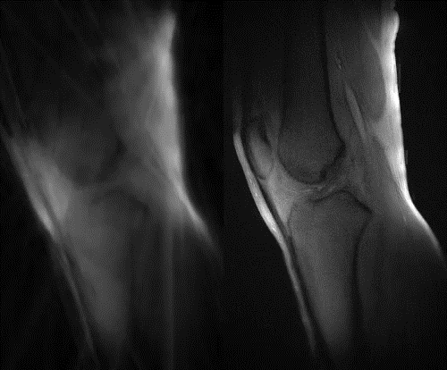
High resolution CINE imaging of guided knee motion using golden-angle radial MRI and a novel knee loading device
5599
Martin Aleksiev¹, Martin Krämer^{1,2}, Nicholas M. Brisson³, Marta B. Maggioni¹, Georg N. Duda³, Jürgen R. Reichenbach¹
¹ Medical Physics Group, Institute of Diagnostic and Interventional Radiology, Jena University Hospital, Friedrich Schiller University Jena, Germany ² Institute of Diagnostic and Interventional Radiology, Jena University Hospital, Friedrich Schiller University Jena, Germany ³ Julius Wolff Institute, Berlin Institute of Health at Charité - Universitätsmedizin Berlin, Germany
Slide 6/8
High resolution sagittal slice acquisition: 320 × 320 matrix size, 210 × 210 mm² FoV, 0.66 × 0.66 x 3.00 mm³ resolution, 10° FA, 2.4 ms TE, 7.0 ms TR, using 65 repetitions with TA of 3:48 minutes and a knee motion speed of 7.5 flexion-extension cycles per minute.
Reconstructed all motion frames using data multiple motion cycles (CINE, right images) and a single motion cycle (real-time, left images)
K-space sampling percentages (for all frames):
Real-time: <10%
CINE: >80%
CINE vs. real-time reconstruction
Notes:
A high resolution scan was used to reconstruct all motion frames using data from a single motion cycle. This is comparable to a real-time acquisition and resulting images are shown on the left.
As a comparison images reconstructed from multiple motion cyles, which is comparable to the typical CINE reconstruction as known from cardiac imaging are shown on the right.
Due to the high spatial resolution most real-time images suffered from strong undersampling artifacts because k-space sampling percentages were below 10% for most frames.
Only the real-time images close to the flexed turning point had acceptable image quality, caused by the naturally slowed down motion speed in this region.
CINE images reconstructed from multiple motion cycles on the other hand had a k-space sampling percentage of above 80% for all frames without suffering from artifacts.

Slide 7
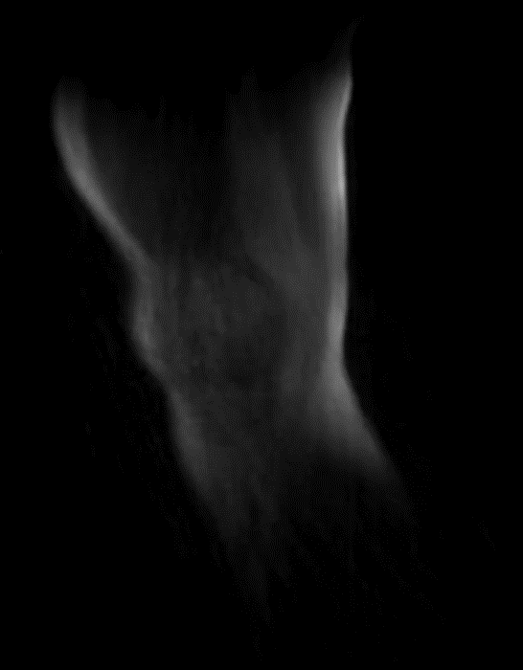
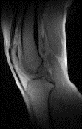
High resolution CINE imaging of guided knee motion using golden-angle radial MRI and a novel knee loading device
5599
Martin Aleksiev¹, Martin Krämer^{1,2}, Nicholas M. Brisson³, Marta B. Maggioni¹, Georg N. Duda³, Jürgen R. Reichenbach¹
¹ Medical Physics Group, Institute of Diagnostic and Interventional Radiology, Jena University Hospital, Friedrich Schiller University Jena, Germany ² Institute of Diagnostic and Interventional Radiology, Jena University Hospital, Friedrich Schiller University Jena, Germany ³ Julius Wolff Institute, Berlin Institute of Health at Charité - Universitätsmedizin Berlin, Germany
Slide 7/8
CINE reconstruction and radial cone 3D UTE sampling can be used to acquire a whole-knee coverage of dynamic MRI data in a single scan (left images)
Alternatively, a 2D golden-angle multi-slice sampling or a 3D golden-angle stack-of-stars sampling is also possible
CINE reconstruction is also feasible with faster leg motion (30 cycles/minute) as shown in the right image
Outlook
Contact
Notes:
As further notes and an outlook on what is possible using the presented acquisition and reconstruction technique we were also able to perform dynamic knee imaging using a 3D radial center-out UTE sampling with whole-knee coverage. Alternatively, other golden-angle based radial sampling strategies such as 3D stack-of-stars or a simple 2D multi-slice acquisition can be used. To be able to perform a comparison to a conventional real-time reconstruction most of the so far shown scans used a relatively slow knee flextion motion. Faster speeds are of course also possible, as demonstrated here on the right with leg motion speed of 30 motion cycles per minute.

Slide 8


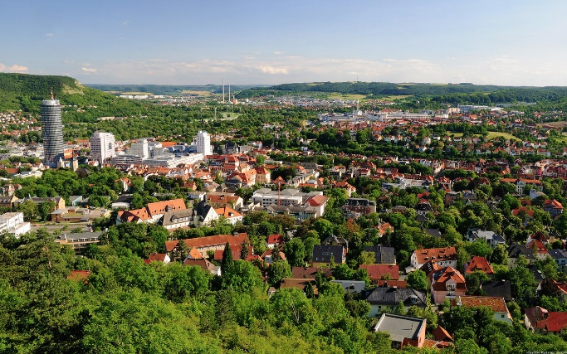
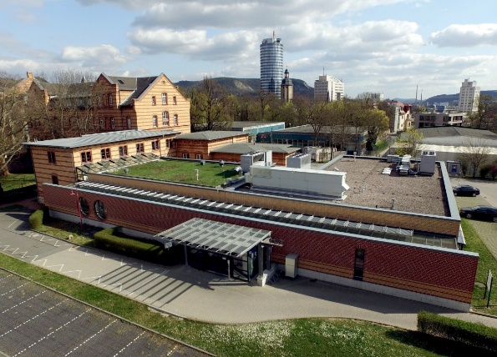
High resolution CINE imaging of guided knee motion using golden-angle radial MRI and a novel knee loading device
5599
Martin Aleksiev¹, Martin Krämer^{1,2}, Nicholas M. Brisson³, Marta B. Maggioni¹, Georg N. Duda³, Jürgen R. Reichenbach¹
¹ Medical Physics Group, Institute of Diagnostic and Interventional Radiology, Jena University Hospital, Friedrich Schiller University Jena, Germany ² Institute of Diagnostic and Interventional Radiology, Jena University Hospital, Friedrich Schiller University Jena, Germany ³ Julius Wolff Institute, Berlin Institute of Health at Charité - Universitätsmedizin Berlin, Germany
Slide 8/8
CINE reconstruction of high resolution dynamic MRI knee images for specific angular positions becomes possible with an MRI-safe device, a rotary encoder and radial golden-angle sampling
Minimizing subject motion is a challenge!
Selecting an appropriate angle window width involves a trade-off between greater knee angle certainty and a greater number of readouts for reconstruction
Discussion and Conclusion
Dr. rer. nat. Martin Krämer
Medical Physics Group
Institute of Diagnostic and Interventional Radiology
University Hospital Jena
Martin.Kraemer@med.uni-jena.de
Contact
Notes:
In conclusion, we have demonstrated that the combination of continuously acquired angular sensor data with a radial golden-angle sampling is advantageous for dynamic
CINE imaging of the knee. The presented acquisition and gating scheme allows high flexibility in data reconstruction and enables not only high-resolution dynamic 2D
imaging but also dynamic 3D imaging of the whole knee. Using this setup, there is great potential for investigating in vivo knee tissue deformations in response to
different knee motion and loading conditions in a time-resolved, detailed and systematic manner in future MRI studies.

